Slide 1
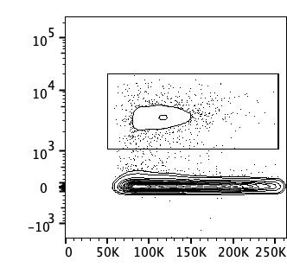
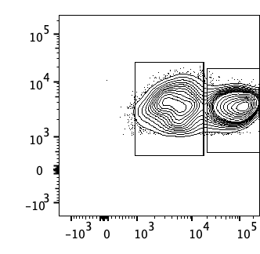
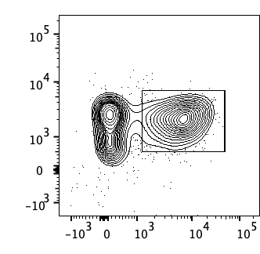
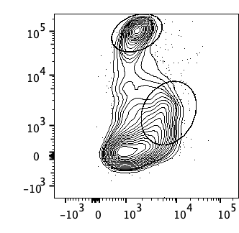
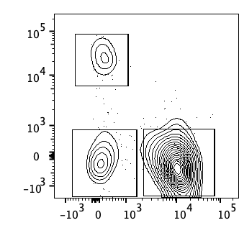
Live cells
CD90.2⁺
αβ T cells
CD45
CD45
CD90.2⁻
CD3
FSC-A
CD90.2
βTCR
CD8 T cells
Monocytes
Neutrophils
CD4 T cells
Ly6C
CD8β
Ly6G
CD4

Slide 2
Live cells
CD45⁺
CD90.2⁺
CD45
CD45
CD90.2⁻
Ly6C
Neutrophils
FSC-A
CD90.2
Ly6G

Slide 3
Live cells
CD45⁺
CD90.2⁺
αβ T cells
CD4 T cells
CD45
CD45
CD3
CD8β
FSC-A
CD90.2
βTCR
CD4

